Slide 1
Module 2: Azure Machine Learning Experiments

Slide 2
Experiment Tracking

Slide 3
Data Science Building Blocks Project
Prepare data, train models
Hyperparameter tuning
pipelines
Deployment
Monitor and Retrain
Classical ML
Deep learning
Data
Data stores
Data sets
Managed Compute
Azure Machine Learning compute cluster

Slide 4
Training Infrastructure
Dependencies and Containers
Leverage system-managed AML compute or bring your own compute
Distribute data
Manage and share resources across a workspace
Schedule jobs
Train at cloud scale using a framework of choice
Scale resources
Autoscale resources to only pay while running a job
Provision clusters
Use the latest NDv2 series VMs with the NVIDIA V100 GPUs

Slide 5
Experimentation
Leverage service-side capture of run metrics, output logs and models
Manage training jobs locally, scaled-up or scaled-out
80%
75%
90%
95%
85%
Use leaderboards, side by side run comparison and model selection
Conduct a hyperparameter search on traditional ML or DNN

Slide 6
Experiment Tracking
Model training is an iterative process.
When experimenting, you may combine different features, hyperparameters, data samples, may try different ways of aggregation. and hence you have to keep track of what specific experiment set up led to what model performance to allow for comparison.
This does help you in three main ways:
it supports your model selection process
it helps steer your experimental process/direction
it allows for reproducibility.

Slide 7
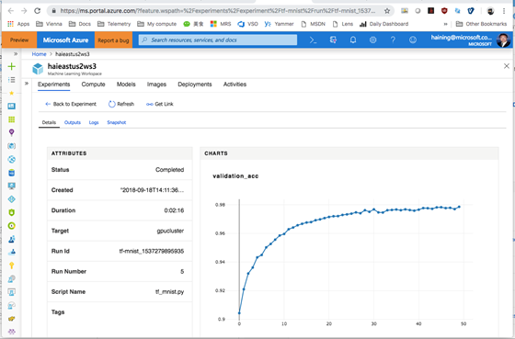
Tracking Experiments with Azure ML

Slide 8
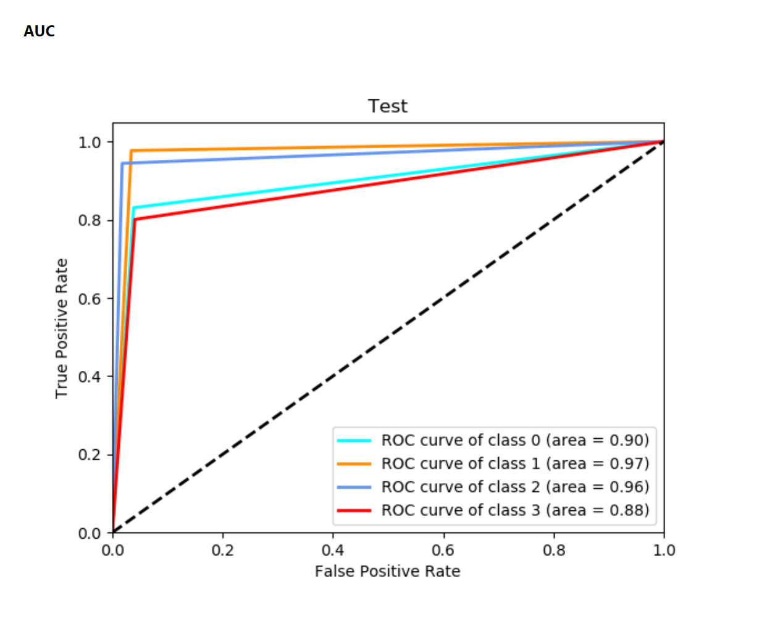
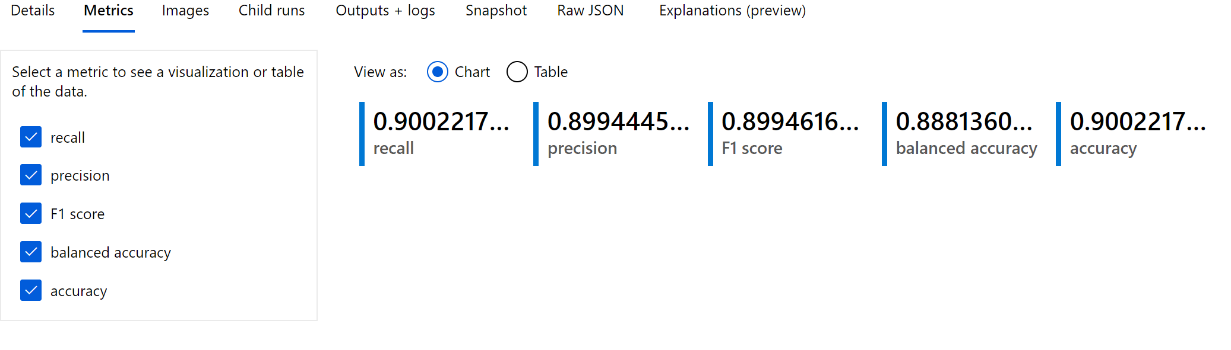
Metrics of one run

Slide 9
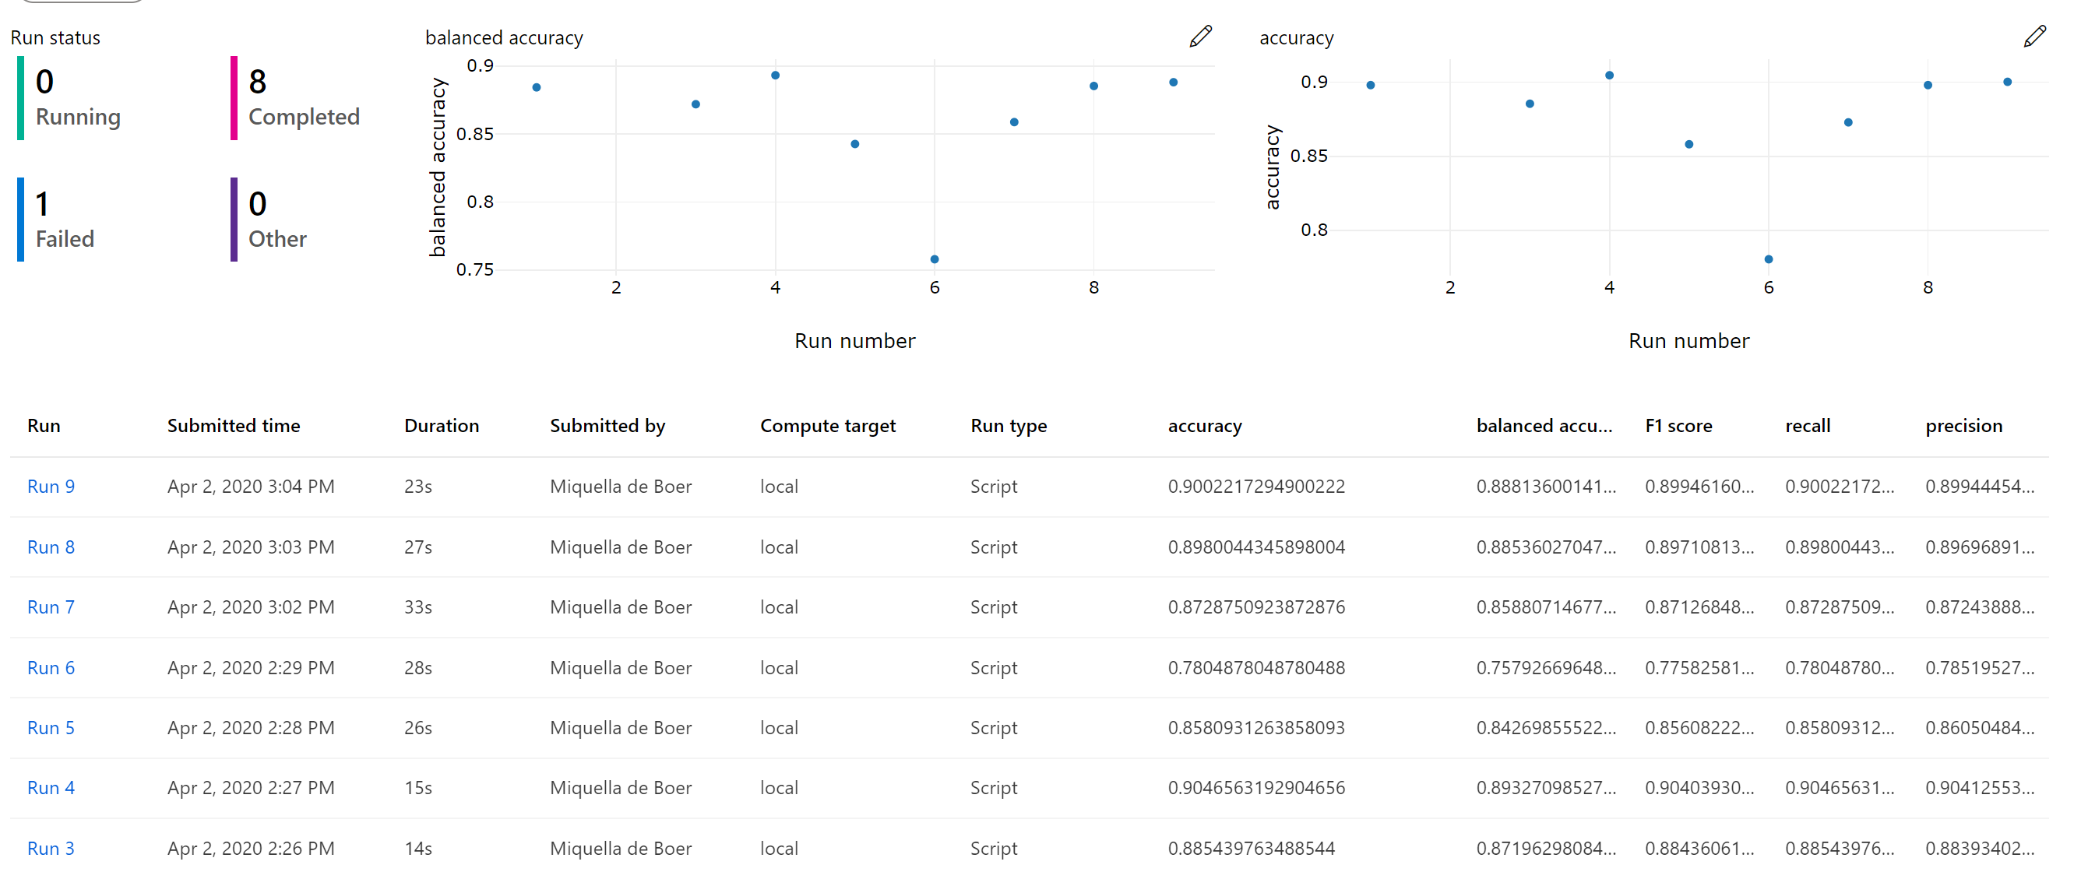
Compare multiple runs

Slide 10
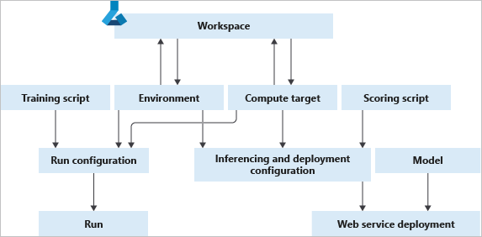
Creating an experiment run with Azure ML

Slide 11
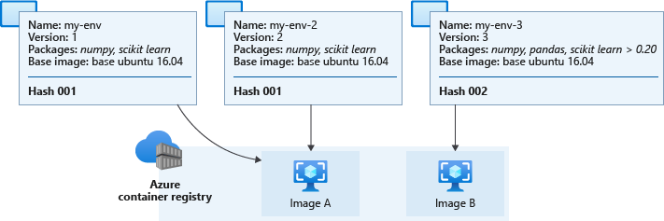
Create an environment

Slide 12
Demo: running experiments with Azure ML

Slide 13
The 20 Newsgroups data set
The 20 Newsgroups data set is a collection of approximately 20,000 newsgroup documents, partitioned (nearly) evenly across 20 different newsgroups. To the best of my knowledge, it was originally collected by Ken Lang, probably for his Newsweeder: Learning to filter netnews paper, though he does not explicitly mention this collection. The 20 newsgroups collection has become a popular data set for experiments in text applications of machine learning techniques, such as text classification and text clustering.
Organization
The data is organized into 20 different newsgroups, each corresponding to a different topic. Some of the newsgroups are very closely related to each other (e.g. comp.sys.ibm.pc.hardware / comp.sys.mac.hardware), while others are highly unrelated (e.g misc.forsale / soc.religion.christian). Here is a list of the 20 newsgroups, partitioned (more or less) according to subject matter:
comp.graphics
comp.os.ms-windows.misc
comp.sys.ibm.pc.hardware
comp.sys.mac.hardware
comp.windows.x rec.autos
rec.motorcycles
rec.sport.baseball
rec.sport.hockey sci.crypt
sci.electronics
sci.med
sci.space

Slide 14

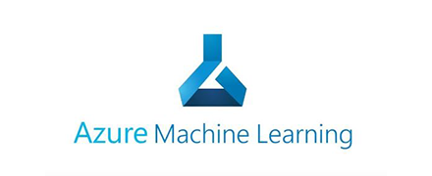
train.py
train_sumit.py
Training script
Run configuration
Conda_dependencies.yml
Experiments
Environment
logs
local
Experiment 1
Compute
local
Data

Slide 15
train.py
train_sumit.py
Training script
Run configuration
Run configuration
Conda_dependencies.yml
Experiments
Environment
logs
local
Experiment 1
Experiment 2
Compute
local
Different
Data

Slide 16
train.py
train_sumit.py
Different
model
Run configuration
Conda_dependencies.yml
Run configuration
Experiments
Environment
Run configuration
logs
local
Experiment 1
Experiment 2
Compute
local
Experiment 3
Data

Slide 17
Lab_02: running experiments with Azure ML

Slide 18
Child runs
Parent Run
Orchestrate the execution of child runs
Child run
Child run
Child run
Child run
Child run
Child run
Child run
1 algorithm
Logs
Graph
1 algorithm
Logs
Graph
1 algorithm
Logs
Graph
1 algorithm
Logs
Graph
1 algorithm
Logs
Graph
1 algorithm
Logs
Graph
1 algorithm
Logs
Graph

Slide 19
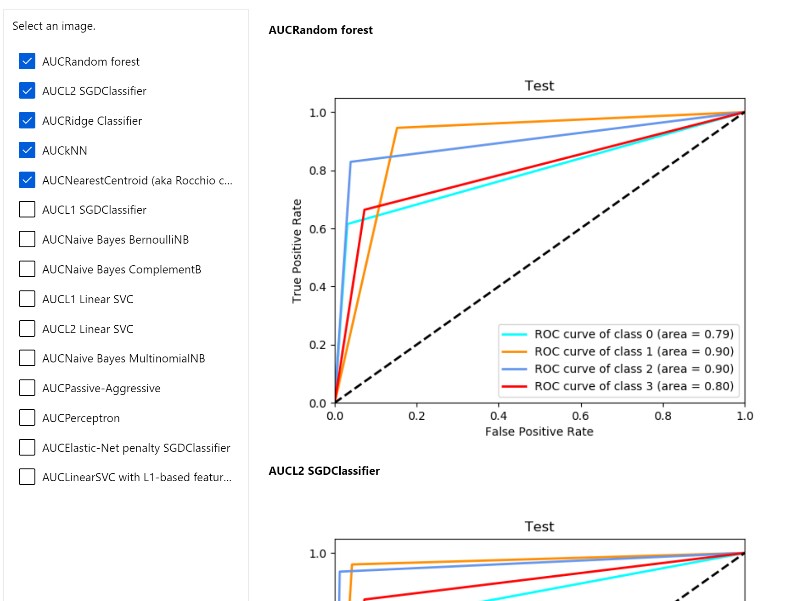
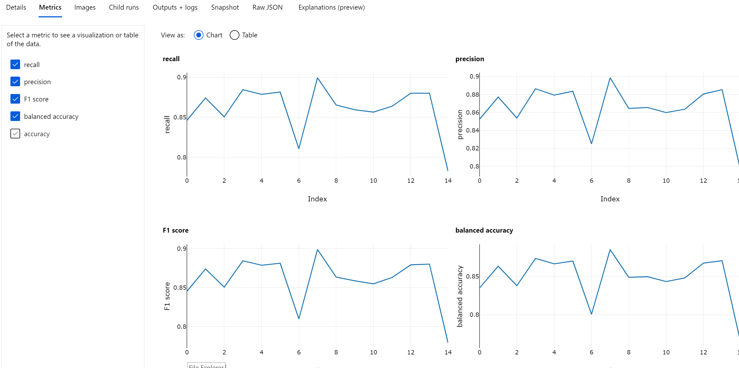
compare metrics across runs

Slide 20
train.py
train_sumit.py
Different
model
Run configuration
Conda_dependencies.yml
Run configuration
Experiments
Environment
Run configuration
logs
local
Experiment 1
Experiment 2
Compute
local
Experiment 3
Data

Slide 21
train.py
train_sumit.py
Training script
Run configuration
Conda_dependencies.yml
Experiments
Environment
logs
local
Experiment 1
Parent Run
Compute
Child run
Child run
Child run
…
local
Data

Slide 22
Lab_03: running experiments with child runs with Azure ML

